Slide 1
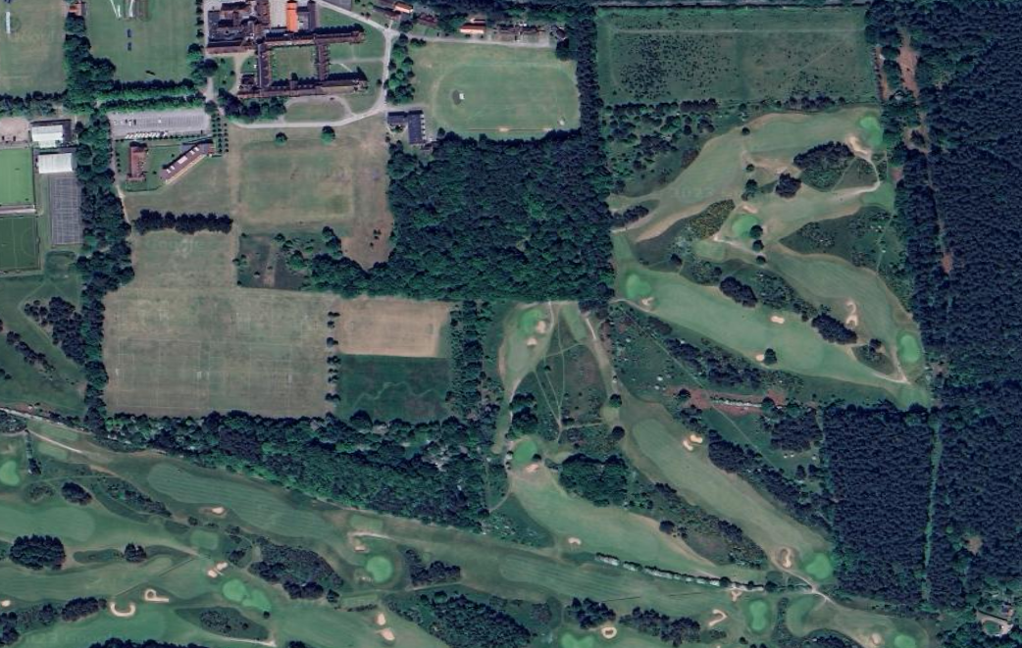
Toward Parking
M
N
G
Toilets (please follow signage)
F
J
H
E
Team Areas /
Registration
GOLF COURSE; PLEASE DO NOT CROSS.
A
K
D
I
B
C
Race Routes / Distances
12:00 Year 8/9 Girls: One lap of red, one lap of yellow (Start, A,B,C,D,E,H,I,A,B,C,D,E,F,G,E,H,I,Finish) 3,500m
12:20 Year 5/6 Girls: One lap of red (Start, A,B,C,D,E,H,I,Finish) 1500m
12:35 Year 8/9 Boys: One lap of red, one lap of yellow (Start, A,B,C,D,E,H,I,A,B,C,D,E,F,G,E,H,I,Finish) 3,500m
12:55 Year 5/6 Boys: One lap of red (Start, A,B,C,D,E,H,I,Finish) 1500m
13:10 Y10/11 Girls: Two laps of yellow(Start,A,B,C,D,E,F,G,E,H,I,A,B,C,D,E,F,G,E,H,I,Finish) 4,000M
13:30 Year 7 Girls: One lap yellow (Start, A,B,C,D,E,F,G,E,H,I,Finish) 2000m
13:45 Year 7 Boys: One lap yellow (Start, A,B,C,D,E,F,G,E,H,I,Finish) 2000m
14:00 Y10/11 Boys: One lap of yellow, one lap of blue (Start A,B,C,D,E,F,G,H,I,A,B,C,D,J,K,L,M,N,J,E,H,I,Finish) 5000m
14:05 LVI /UVI Boys: Two laps of blue (Start, A,B,C,D,J,K,L,M,N,J,E,H,I,A,B,C,D,J,K,L,M,N,J,E,H,I,Finish) 6,000m
14:05 LVI/UVI Girls: One lap of red, one lap of blue (Start,A,B,C,D,E,H,I,A,B,C,D,J,K,L,M,N,J,E,H,I,Finish) 4,500m
L

